Slide 1
More Ideas for the Independent Study Fall 2013
Wencan Luo
09/06/2013

Slide 2
Outlines
I: Modeling Conflict in Multi-part Dialogues
II: Graph Modeling of Team Cooperation
III: Picture Your Speech
IV: Comparison of Word Clustering Algorithms on Semantic Role Labeling

Slide 3
I: Modeling Conflict in Multi-part Dialogues

Slide 4
II: Graph Modeling of Team Cooperation
5 Different Types of Leadership

Slide 5
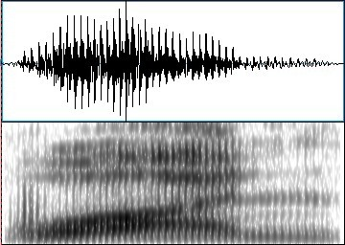
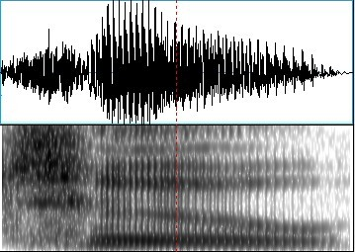
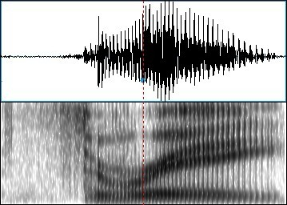
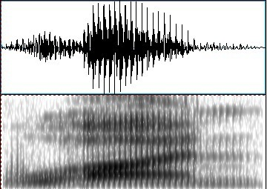
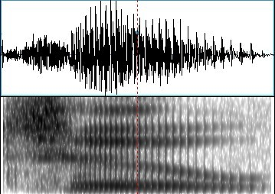
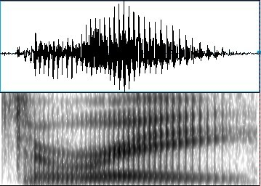
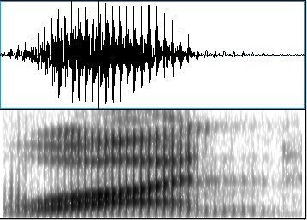
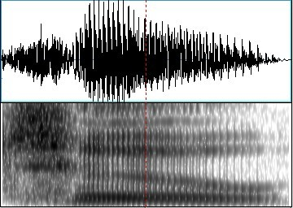
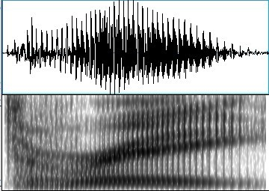
III: Picture Your Speech
Recognize the Speech from its picture
One
Two
Three
Notes:
speech spectrum, spectrogram

Slide 6
Motivation
Translate 1-d speech to 2-d image
Deep learning on pictures is better
Similar spectrogram for same speech, but different spectrogram for different speech

Slide 7
IV: Comparison of Word Clustering Algorithms on Semantic Role Labeling
Group similar word together
Out-of-Vocabulary (OOV) Problem
Sparsity Problem
Biology support: people have semantic memory
Question
How good are they?
Notes:
Memory is organized around personal experiences or episodes rather than around abstract semantic categories

Slide 8
Word Clustering Methods
Brown et al., 1992
LSA
LDA
Deep Learning
Others
Maas et al., 2012

Slide 9
Extrinsic Task
Semantic Role Labeling
CoNLL-2004 and CoNLL-2005 Shared Tasks
Data
PropBank

